Slide 1
An Independent Software Testing Company

Slide 2
About Us
Most businesses think that product is the most important thing, but without Quality won't make a product successful
8+
12+
200+
50
2
Years in Business
Awards Won
Projects Finished
Engineering Team
Offices
Financially Stable

Slide 3
Our Vision & Value
Vision : Most Trusted Testing Company
Client Value Creation
B
A
A
Customer First
B
Creativity is the key to success in the great
Creativity is the key to success in the great
Quality
Teamwork
D
C
C
Creativity is the key to success in the great

Slide 4
Our Workspace
Office
Monday to Friday
Description
A fast-paced, buzzing environment with great diversity – a place where the customer is always the centre of attention. Employee are our success, and we are committed to being a good employer.
By providing a fun, creative and dynamic workplace, we all grow together.
Our working approach is shaped by a strong respect for each individual.
This applies to every aspect of the employment – from wages, working hours and freedom of association, to equal opportunities for growth and development within the company. Every employee has the right to discuss work-related issues directly with management.
Drink Coffee
Mobile
Love

Slide 5
Why Work With Us ?
Testing After Hour
One Stop QA Shop
Testing Around the Clock
High RoI on QA Investments
Seasoned QA Professionals
Proven Expertise in Large Scale Testing Programs

Slide 6
We Work With
STARTUPS
SMALL BUSINESS
ENTERPRISE

Slide 7
Industries We Work
FinTech
Health Care
Social
E-Commerce
Cloud
CRM
Banking
Retails
Telecom
Insurance
Mobile
Enterprise

Slide 8
Our Services
Automation Testing
Load and Performance Testing
Mobile Testing
Code Verification
Security Testing
Manual Testing
Big Data Testing
ERP & IoT Testing

Slide 9
Automation Testing
Commit to Repository
Commit to GIT/Bitbucket
Development of Scripts
Distribute Test on Cloud
Development in C# or Java
Enhancement
Test Data Preparation
Integration with CI
Integration with Sauce Lab/Browser stack
Review Manual Testcases
Automated Report Generation
/Share Results
Define Use Cases/TestCases
Review & Approval
Test Execution
Defect Management
Prepare Summary Report
All registration marks are the property of their respective owners.

Slide 10
Mobile Testing
Define
Develop
Test Strategy
Device Identification
Analyze Market Trends
Develop TestCases
Lab Set up
End to end Testing Setup
Automation
Deliver
Real Handsets Testing
Pre-Market handsetsTesting.
iOS Automation
Andriod Automation
Device Certification
All registration marks are the property of their respective owners.

Slide 11
Performance Testing
optimization
Load Test
Define & Design
Develop
Health
Define Performance Requirement
Select Performance Testing Tools
Procure Pre-Prod Test Environment
Define Test Data
Identify Potential Risks
Installation of tools
Populate Test Data
Design Test Scripts
Dry run on Test Scripts
Analysis
tools
Users load
TEST
traffic
mobile
target
performance
Analysis & Certify
Test & Tune
Analysis based on performance Data
Capacity measurement for web/DB server
Final summary report Preparation
Execute The Scripts
Tune Application Server
Tune DB Server
Tune the infrastructure
All registration marks are the property of their respective owners.

Slide 12
Code Testing
Analyze your Software Code
Know the Quality Factor
Locally and on cloud
Integrate your dev life cycle
Risk
Metrics
Defect.
Governs Your Application
Manage Quality Model
Take decision about your application
Explore best repair scenarios
Define your own or use ours
Choose Best Practice & metrics
Define your Portfolio
All registration marks are the property of their respective owners.

Slide 13
Security Testing
Web VAPT Testing
Network Testing
iOS App Testing
Intrusion Detection
Andriod App Testing
Threat Detection

Slide 14
Manual Testing
Cross Browser Test
UI/UX Test
Web Responsive Test
Installation Test
Functional Test
IoT Test

Slide 15
Our QA Methodology
INITIATION
DETAILS PRODUCT UNDERSTANDING
TEAM FORMATION
TEST DESIGN
TEST CASE CREATION
REVIEW TEST CASES
TEST EXECUTION
REPORTING
TEST CASE EXECUTION
BUG TRIAGE MEETING
TEST REPORTING
METRICS REPORTING
RESULTS ANALYSIS
TEST RESULTS ANALYSIS
MEETING WITH QA & DEV
TEST AUTOMATION
TEST METRICS
IDENTIFICATION OF IMPROVEMENT AREA
REGRESSION TEST
KNOWLEDGE TRANSFER
TEST ENVIRONMENT
TEST STRATEGY BUILDING
TEST CYCLE CLOSURE

Slide 16
Engagement Model
Offshore Testing
Fixed Price
Time & Material
Pilot Project
On Site Testing
Our engagement model is modular and is designed in such a way that it reflects our passion and work culture as well as aims to understand your needs on a priority basis.

Slide 17
Our Awards
2
1
1
3
2013
2015
2016
2017
India
Best Software Company in Gujarat State
10 Most Software Testing Promising Company in India by Silicon India
India
Top 20 Start-up IT services in India by Start-up city
India
10 Fastest Growing Software Testing Companies 2016
.
India/Australia
20 Most Promising Testing Provider
Recognized Top 100 MSME by Vibrant Gujarat
Approved NSW ICT Services Provider

Slide 18
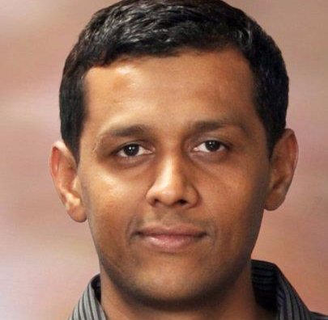
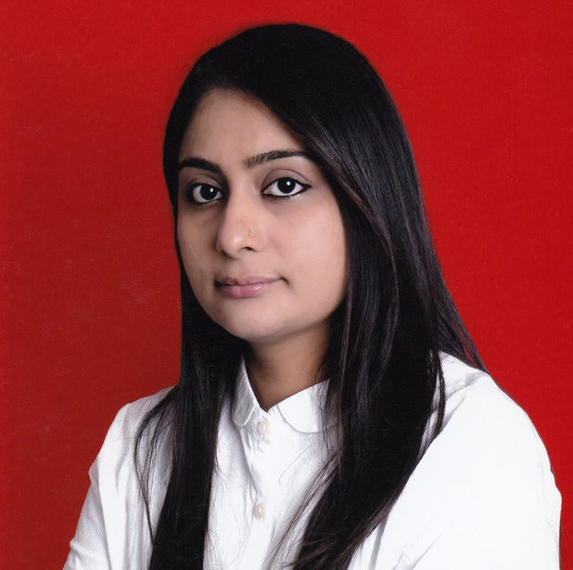
Meet Our Great Team
Niranjan Limbachiya
Nirav Raval
Shital Limbachiya
CEO - FOUNDER
PARTNER
MD
Niranjan heads KiwiQA as a CEO.
He is the chief quality officer for the team. He is a responsible for the innovation, defining the service lines, methodologies, customer delivery , human resource and overall operations.
He is a charismatic and energetic QA leader with a proven track of record of 12+ years.
Nirav is a partner at KiwiQA.
He has 12+ years of professional and entrepreneur experience in building operations, raising a finance, joint venture alliance and a commercial acumen towards driving business.
He is a responsbile for driving growth related initiative at KiwiQA. He is active in renewable energy , information technology ,consulting and retails sectors.
Shital is a MD at KiwiQA.
She has business-management skills to drive gains in revenue, market share and profit performance.
She is responsible for business strategic & sales vision. Also building relationships with new prospects and existing customers.

Slide 19
Our Clientele
FinTech
Business
Social
All registration marks are the property of their respective owners.

Slide 20
Our Clientele
E-Commerce
Video
Web Dev
All registration marks are the property of their respective owners.

Slide 21
Contact Us
AUSTRALIA
Suite 309, 20A
Lexington Drive
BellaVista NSW 2153
INDIA
Office No 1, 4 D Square Mall
Visat Gandhinagar Highway
Ahmedabad GUJ , India 384170
Sales Phone & Email
Direct Line (AUS): +61 – 0410 757 121
Direct Line (India): +91 – 99099 87042
Sales@kiwiqa.com/Sales@kiwiqa.com.au
Social Media
Facebook.com/KQSPL
Twitter.com/KQSPL
Linkedin/Kiwiqa
Youtube.com/kqsplmobiletesting

Slide 22
THANK YOU
Every Accomplishment Starts With the Decision to try

